Slide 1
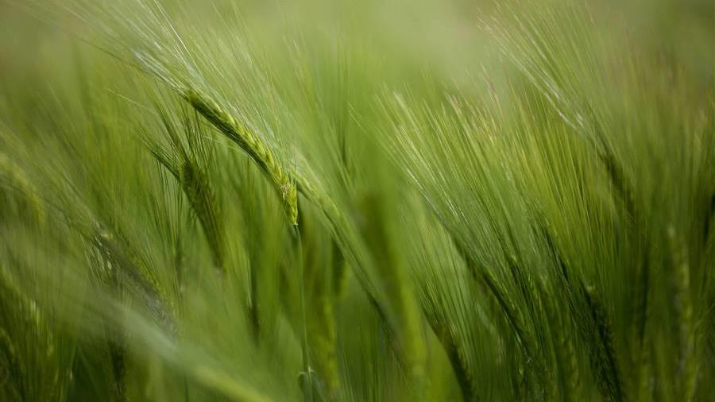
Final Project – DATA 604 Simulating: DMV Wait times
Lisa Szydziak
July 13, 2022

Slide 2
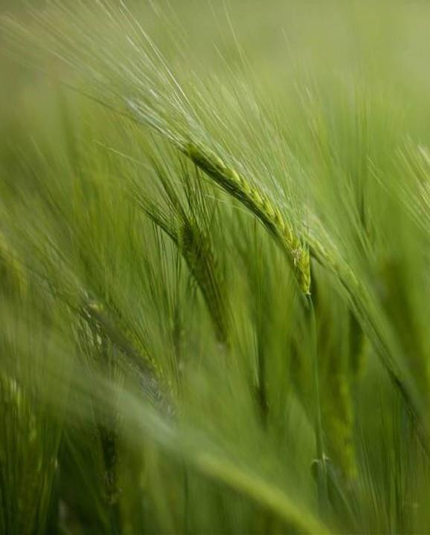
Assignment
Using SimPy, write a process simulation that includes waiting time (discrete event simulation). You may use any topic of interest to you. Write the simulation and all of the following in Jupyter.
Each element is worth 5 points and will be graded using the rubric shown here.
State the problem and its significance.
Provide a flow-chart model.
3. Simulate the process for the appropriate number of iterations (justify)
4. Justify the validity of the model and discuss how you verified it.
5. State your conclusions/ findings from the model.
6. Generate appropriate graphs (more than one) to illustrate the results and provide a PowerPoint presentation to share with your colleagues. Post this to the discussion.
Be sure that your code works!

Slide 3
STATE THE PROBLEM AND THE SIGNIFICANCE
PROBLEM:
Waiting in line at the department of motor vehicles or motor vehicle registry is a necessity of modern day living which is unavoidable. Customers dread this situation in which you must appear in person because of the insanely long waits at the registry.
Simulate wait time at the Department of Motor Vehicles (DMV).
SIGNIFICANCE:
This information can be helpful in reducing wait time by adding additional servers at busy times when wait times are expected to exceed a reasonable time.
Let's take a look at a couple of simulations using 1,2,3 servers based on exponential customer arrival times and service times and plot the results.

Slide 4
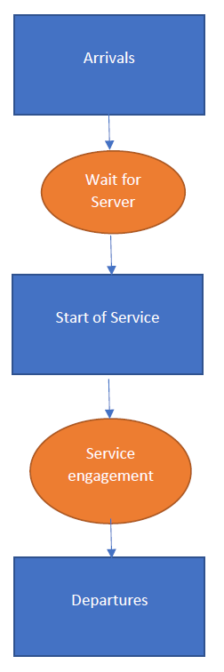
PROVide a FLOW CHART MODEL
The flow chart below depicts the flow of a customer at the DMV

Slide 5
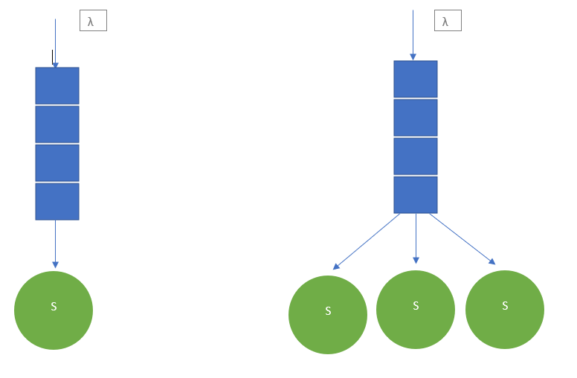
Flow chart con’t
Flow charts of queues with 1 and 3 servers

Slide 6
Simulate the process for the appropriate number of iterations
Let's try to run the simulation model with 1 server, then repeat with 2, 3 servers.
Assumptions:
Suppose we are given the information:
The average time to serve a customer is 10 minutes, or in order words, .1 customers are served per minute. The average time between customers arriving is 3.3 minutes, or .3 customers arrive per minute.
Let's assume these times are exponentially distributed.
Process run / Iterations:
Try the simulation with 1 server:
The simulation was run for n=120 (a random seed was set for descriptive purposes).
This was chosen to look at a 2 hour time period from opening. We are looking to see if the queue becomes to grow unmanageable. If this occurs, we need more servers to accommodate the influx of customers.

Slide 7
Simulation n=120 with 1 Server
Excerpt of simulation:
0.14624127844428425 customer 1 arrives
0.14624127844428425 customer 1 is being served
0.41854463050909413 customer 2 arrives
0.608589561988669 customer 3 arrives
1.5900317205020897 customer 4 arrives
1.93899649915988 customer 1 departs
1.93899649915988 customer 2 is being served
2.2802460271838054 customer 5 arrives
6.762223993436342 customer 2 departs
6.762223993436342 customer 3 is being served
6.776627034487789 customer 6 arrives
7.502117961346676 customer 7 arrives
26.989735817615298 customer 3 departs
26.989735817615298 customer 4 is being served
……….

Slide 8
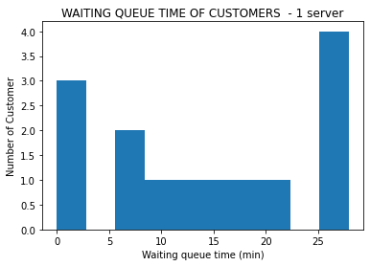
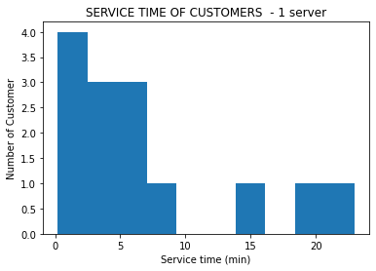
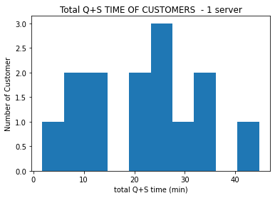
Simulation n=120 with 1 Server con’t
Here are some metrics from the simulation:
Customers_handled (1 server): 14
Customers_arrived (1 server): 27
CustomerID_last in service (1 server): 15
Length of queue (1 server): 12
Average Customer Queue time (1 server): 14.517493727578339
Average Customer Service time (1 server): 7.148903884702712
Average Customer Total Q+S time (1 server): 21.666397612281052
Customer Arrival rate (1 server): 0.225
Customer Service rate (1 server): 0.13988158410407628
t-test service time pop mean=10: pvalue=0.16454125210818848
Time in the system is comprised of Queue Wait time + Service Time = Total (Q+S) Time
Below are histograms of the 3 measurable time segments:

Slide 9
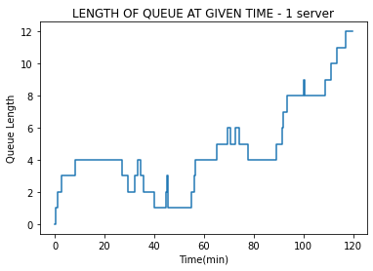
Simulation n=120 with 1 Server con’t
The line starts to grow quite starkly. This situation is not going to work, let's add another server to our simulation.

Slide 10
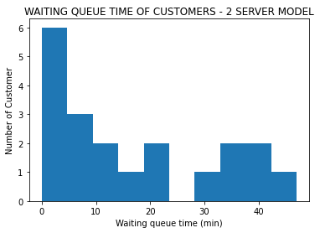
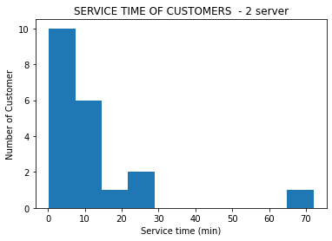
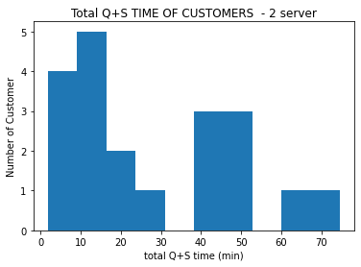
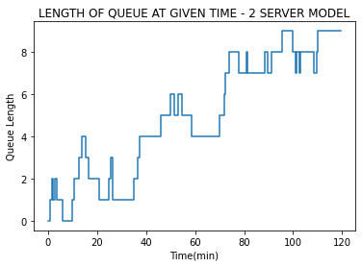
Simulation n=120 with 2 Server
Here are the results of the simulation with 2 servers, the line continues to grow as the time goes on.
Here are the results of the simulation with 2 servers, the line continues to grow as the time goes on.
We will consider a model with 3 servers.

Slide 11
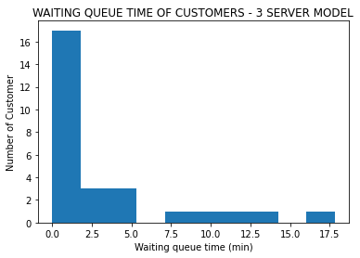
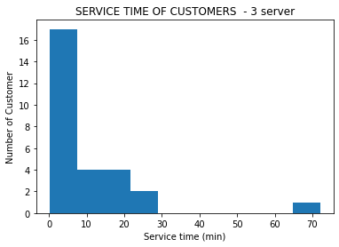
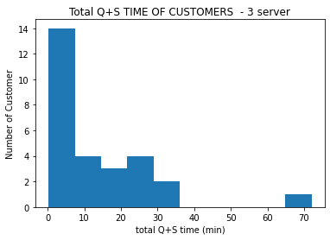
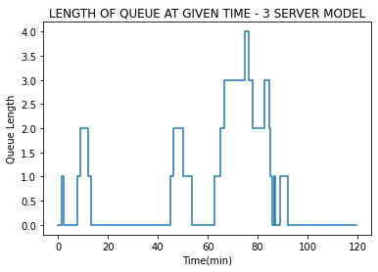
Simulation n=120 with 3 Server
Here are the results of the simulation with servers, the line continues to grow as the time goes on.
Here are the results of the simulation with 3 servers, the queue remains stable and under control.
.

Slide 12
Justify validity of the model and discuss how you verified it
The problem of understanding DMV wait times is a subject that has been carefully scrutinized. Does the conceptual model represent the real system accurately?
Although a random seed was set for descriptive and illustrative purposes, the simulations were run several times (n=120) with consistent results assuring verification and validation. The model was built with the ability to change parameters: simulation time, servers, customer arrival time, service time.
Validation
"Validation is the process of comparing two results. In this process, we need to compare the representation of a conceptual model to the real system. If the comparison is true, then it is valid, else invalid.“
The model's key assumptions lie in customers arriving and customers serviced. We have assumed these parameters based on educated guesses and research as part of the validation. The model is built so that these parameters can be adjusted as well.
The average time to serve a customer is 10 minutes, or in order words, .1 customers are served per minute.
The average time between customers arriving is 3.3 minutes, or .3 customers arrive per minute.
We have assumed these times are exponentially distributed.
ref: https://www.tutorialspoint.com/modelling_and_simulation/modelling_and_simulation_verification_validation.htm

Slide 13
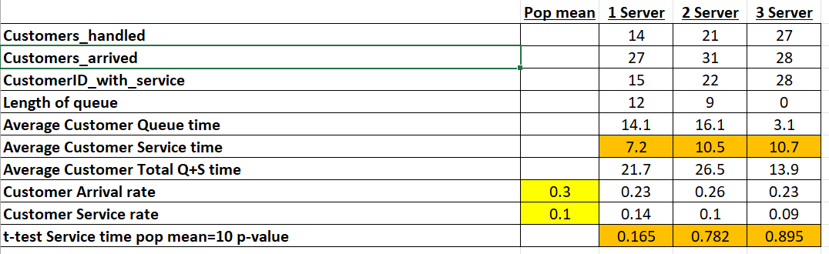
Validation and verification con’t
Assumption of customer arrival rate=.3 and the simulations produced similar results: .23, .26, .23.
Assumption of customer service rate=.1 and the simulations produced: .14, .1, .09.
Aassumption of average customer service time=10 and the simulations produced: 7.2, 10.5, 10.7
For illustrative purposes, a one sample t-test using population mean customer service time=10 resulted in no significant difference.

Slide 14
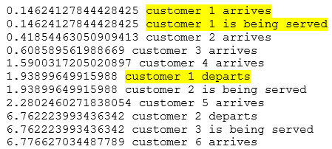
Validation and verification con’t
The service time is exponentially distributed as the The simulation of the 3 server model has produced a service time plot depicted an exponential distribution as output. This was the assumption on input.
The plot for the server2 and server1 shown previouslyis similar in shape.
Verification:
The flow charts shown earlier depict the flow of customers in the actual system and the model follows this flow. The flow chart specifies 1) customer enters, 2) customers may wait, 3) customers are served, 4) customers depart. Our simulation follows this flow.

Slide 15
Conclusions and findings
This model does accomplish the goal of simulating the queue at a DMV. The model was run with 1,2 and 3 servers. Reviewing the results of the simulations, it can be concluded that a 3-server configuration adequately serves the customers.
From California's DMV blog: "DMV’s existing goals are for wait times (amount of time in the queue) to not exceed 45 minutes for customers without an appointment or 15 minutes for customers with an appointment. “ It is pertinent to study the DMV wait times, service times and queue length and this problem is a real applicable use for simulation.
Future improvements to this simulation model could prove to be practical. For example, adding servers periodically, modifying to allow for appointment/non-appointment queues, changing arrival time distributions throughout the day to name a few enhancements possible.

Slide 16
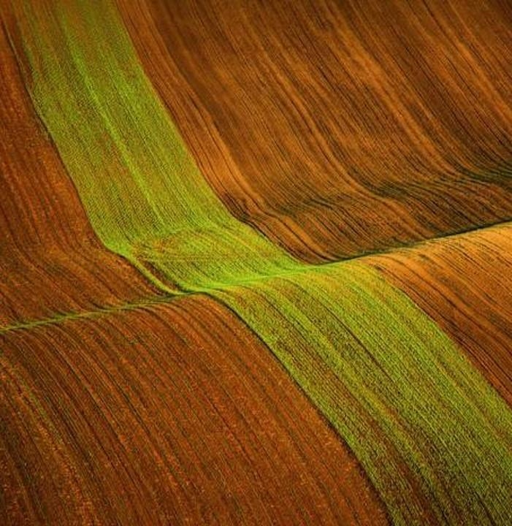
Thank you

